Slide 1
Department of E&TC Project ID: A-14
Pimpri Chinchwad Education Trust’s
Pimpri Chinchwad College of Engineering, Pune
CONTAIN-BASED INNOVATIVE SEWAGE MONITORING SYSTEM USING IOT
Presentation By: Guided By:
Mayur Ingle | BTETA41
Ganesh Jagtap | BTETA42
Manoj Gotmukle | BTETA37
Shantanu Bhapkar | BTETA15
Mrs. Suvarna kadam

Slide 2
Outline
Introduction
Problem Statement
Objectives
Literature Review
Aim
Methodology
Design and Implementation
Software Implementation
Results
Advantages
Applications
Conclusion
Future Scope
References
Project Outcome
.

Slide 3
Introduction
The Contain-Based Sewage Monitoring System, powered by the Internet of Things (IoT), is changing how cities manage wastewater.
It uses smart sensors in sewage units to instantly gather data on sewage levels and quality.
This information is sent wirelessly to a central system in the cloud, so people can monitor and react to sewage issues in real-time.
The system helps make sewage management more efficient, promotes eco-friendly practices, and tackles problems like pollution and public health.

Slide 4
Problem Statement
How Contain-Based Sewage Monitoring System addresses current urban sewage management gaps by improving real-time monitoring, proactive maintenance, and regulatory compliance to enhance wastewater infrastructure efficiency and environmental safety

Slide 5
Objectives
To provide a methodology to carry out the intended task based on the previous research and newly added functionalities or by different methods.
To revolutionize urban sewage management by integrating advanced sensor technology, real-time data analytics, and Internet of Things (IoT) connectivity.
To connect the Sewage Monitoring System to IOT.

Slide 6
Aim
To enhance monitoring accuracy, enable proactive maintenance, mitigate environmental risks, optimize resource utilization, and ensure regulatory compliance, fostering sustainable and efficient wastewater infrastructure management.

Slide 7
Literature Review
Sr. No | Title | Year | Publication | Methodology | Conclusion
1 | Renovation of automation system based on Industrial Internet of Things: A case study of a sewage treatment plant | 2020 | IEEE | The study implements an IoT-based automation renovation for a sewage treatment plant, utilizing a central controller with an STM32 processor and integrating the We Chat Applet as the extended host computer. The paper details the field hardware system, wide-area monitoring, control application program, management cloud platform, and security technologies. | The practical application of IoT in upgrading legacy automation devices for a sewage treatment plant demonstrates high accuracy, real-time performance, reliability, and cost-effectiveness. This success underscores the potential of IoT in addressing challenges associated with industrial automation upgrades, offering a valuable contribution to enhancing efficiency and reducing costs in traditional industries.

Slide 8
Literature Review
2 | Internet of things for secure surveillance for sewage wastewater treatment systems | 2022 | Science Direct | The paper introduces the Surveillance-based Sewage Wastewater Monitoring System (SSWMS) with IoT, employing smart water sensors to monitor water quality, pressure, and temperature throughout the wastewater treatment facility. The proposed method calculates the facility's effectiveness, ensuring chemical releases remain below allowable levels. | Experimental results demonstrate a significant improvement in recycling water quality (97.98%) using the SSWMS with IoT, showcasing enhanced secure communication and reduced moisture content compared to alternative methods. This highlights the system's potential in effectively monitoring wastewater treatment, contributing to improved water quality and environmental sustainability
3 | Use long short-term memory to enhance Internet of Things for combined sewer overflow monitoring | 2018 | Science direct | This study focuses on addressing combined sewer overflow (CSO) issues by utilizing Internet of Things (IoT) data to monitor CSO structures. Different neural network models, including multilayer perceptron (MLP), wavelet neural network (WNN), long short-term memory (LSTM), and gated recurrent unit (GRU), are employed for simulating and predicting CSO structure water levels | Comparative analysis reveals that LSTM and GRU neural networks demonstrate superior capabilities for multi-step-ahead time series prediction in the context of CSO water level simulation. Notably, GRU exhibits performance similar to LSTM but with a quicker learning curve, emphasizing its efficiency for effective prediction and control of CSO-related water issues.

Slide 9
Literature Review
4 | SMART SYSTEM FOR MONITORING WATER QUALITY PARAMETERS | 2022 | IEEE | This article introduces a three-level smart system for water quality monitoring, involving the processing of water samples at supply sources, distribution networks, testing laboratories, and data from water consumption accounting systems. The system emphasizes real-time quality control and power consumption, utilizing wireless communication technologies for result transmission to consumers. | The implementation of smart systems in water quality assurance is crucial for rational water resource development and management. The proposed three-level smart system enhances real-time monitoring, ensuring the efficient processing of testing results and data transmission through wireless communication technologies. .
5 | IoT Based Sewage Monitoring System | 2020 | SSRN Electronic Journal | This paper focuses on developing an IoT-based system to measure and analyze real-time levels of toxic gases, humidity, and temperature in harsh working conditions, aiming to enhance worker safety. The system utilizes sensors to detect various gases, continuously monitoring and sending alerts to authorized personnel remotely if levels exceed predefined thresholds. Additionally, live video streaming is implemented to monitor and address any blockages encountered during the process. | The proposed IoT technology demonstrates potential for improving workplace safety by providing real-time monitoring of toxic gas levels, humidity, and temperature. The integration of alert systems and live video streaming enhances the ability to respond promptly to unsafe conditions, ensuring the well-being of workers in challenging environments

Slide 10
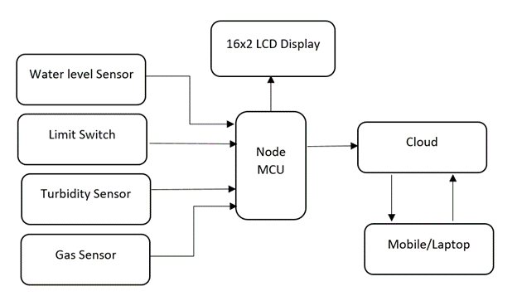
Methodology
Block Diagram

Slide 11
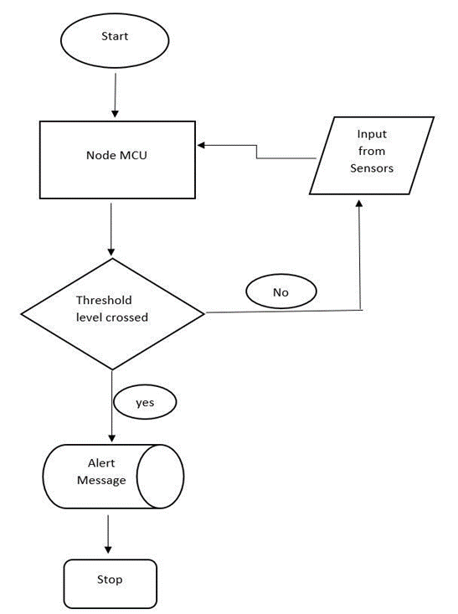
Methodology
Step1:-Start
Step2:-Take Input from Sensors to Node MCU
Step3:-Check Threshold level
Step4:-If Condition is True/Yes
Step5:-Send Alert Message
Step6:-Repeat Process
Step7:-If Condition is False/No
Step8:-Process should repeat in loop until condition getting “True”
Step9:-End
Fig. FLOW CHART

Slide 12
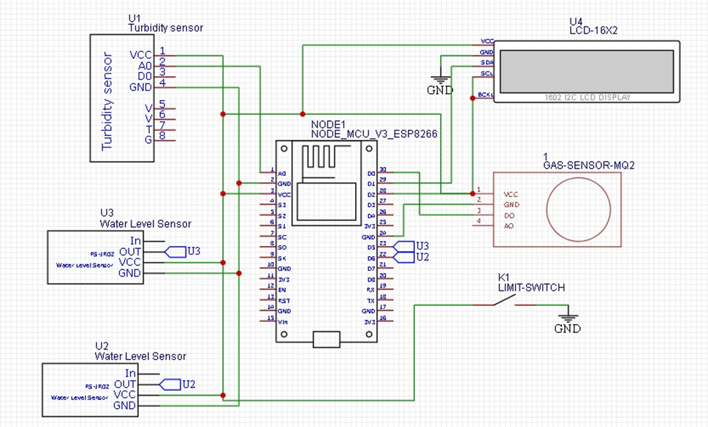
Design and Implementation
Circuit Diagram
This circuit diagram contains the interface of the Sensors with nodeMCU shown in Figure
Fig .Circuit Diagram

Slide 13
Design and Implementation
Hardware Implementation
Setup Arduino IDE: Download and install the Arduino IDE from the official Arduino website. Ensure to install the ESP8266 Board Support Package by following the instructions in the Arduino IDE's Board Manager.
Install Libraries: Install the necessary libraries for the GSM module and gas sensor (if available). You can do this by navigating to the Arduino IDE's Library Manager and searching for the respective libraries.
Write Firmware Code: Write the firmware code in the Arduino IDE. This code will include functions to initialize the GSM module, connect to the cellular network, read data from the gas sensor, and send SMS alerts when gas levels exceed a certain threshold.
Compile and Upload: Compile the firmware code and upload it to the NodeMCU board. Select the correct board (e.g., NodeMCU 1.0) and COM port in the Arduino IDE before uploading the code.

Slide 14
Design and Implementation
Testing and Debugging: Test the system to ensure it functions as expected. Use serial debugging output to troubleshoot any issues and make necessary adjustments to the firmware code.
Integration: Integrate the NodeMCU board, GSM module, and gas sensor into your hardware setup. Make sure to provide adequate power and connections between the components.
Deployment: Deploy the system in the target environment and monitor its performance. Make any necessary adjustments or optimizations based on real-world usage.

Slide 15
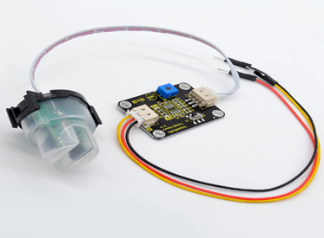
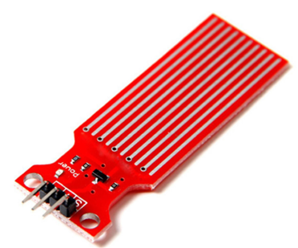
Design and Implementation
Hardware Specification
1. Turbidity Sensor
2. Water Level Sensor
Turbidity Sensor
Water Level Sensor
MLX90614: Non-contact temperature measurement
Measurement Range: 0 - 1000 NTU (Nephelometric Turbidity Units)
Accuracy: ±2% of reading or ±0.1 NTU, whichever is greater
Resolution: 0.01 NTU
Response Time: < 5 seconds
Calibration: Factory calibrated, with the option for user calibration every 6 months
Operating Temperature Range: 0°C to 50°C
Power Requirements: 12 - 24 VDC
LM35: Precision temperature sensor
Measurement Range: 0 - 10 meters
Accuracy: ±1% of full scale
Resolution: 1 millimeter
Response Time: < 1 second
Operating Temperature Range: -20°C to 60°C
Pressure Range: 0 - 1 bar (for submersible sensors)
Power Requirements: 5 - 24 VDC

Slide 16

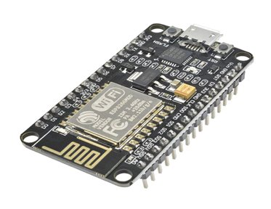
Design and Implementation
3. Limit Switch
4. Node MCU
Limit Switch
NodeMCU
Operating Principle: Mechanical lever-operated switch
Contact Configuration: Normally Open (NO), Normally Closed (N.C.), or Changeover (SPDT)
Contact Rating: Typically 5A at 250VAC or 30VDC
Operating Force: Approx. 0.5 - 1.5 N
Actuation Distance: Typically 1 - 10 mm
Release Distance: Typically 1 - 10 mm
Operating Temperature Range: -20°C to 80°C
Environmental Protection: IP67 rated for dust and water resistance
Microcontroller: ESP8266EX
Operating Voltage: 3.3V
Input Voltage: 4 - 9V (recommended)
Digital I/O Pins: 11 (can be used as GPIO, P.W.M., I2C, and more)
Analog Input Pins: 1 (3.2V max input)
Clock Speed: 80MHz (can be overclocked up to 160MHz)
Flash Memory: 4 M.B.

Slide 17
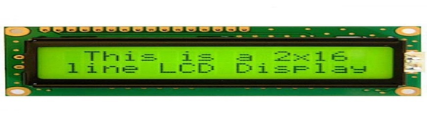
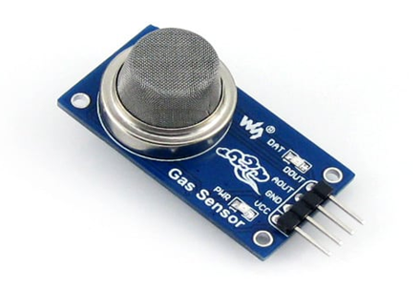
Design and Implementation
5. LCD Display
6.Gas Sensor
LCD Display
Gas Sensor
The operating voltage of this display ranges from 4.7V to 5.3V
The display bezel is 72 x 25mm
The operating current is 1mA without a backlight
P.C.B. size of the module is 80L x 36W x 10H mm
HD47780 controller
Gas Detection Principle: Metal Oxide Semiconductor (M.O.S.) sensor
Target Gas: Carbon Monoxide (C.O.)
Measurement Range: 10 to 10,000 ppm (parts per million) C.O.
Sensitivity: > 3% of Full Scale
Response Time: < 10 seconds
Accuracy: ±10% of Full Scale
Operating Temperature Range: -10°C to +50°C
Power Requirements: 5V DC, 150mA (heater), 30mA (analog output)

Slide 18
Software Implementation
Software Required
Arduino IDE
The Arduino Integrated Development Environment (IDE) is used to write, compile, and upload code to the Arduino Uno board.
Arduino Libraries
Depending on the specific sensors or modules you're using with the Arduino Uno, you may need to install additional libraries to interface with them. For example, if you're using a gas sensor, you might need to install a library that provides functions to read data from the sensor and perform any necessary calculations.
Serial Monitor
The Arduino IDE includes a Serial Monitor tool that allows you to communicate with the Arduino Uno board over the serial port. You can use the Serial Monitor to view debug messages, sensor readings, and other output from your Arduino sketch.
Text Editor
While the Arduino IDE provides a built-in code editor, some developers prefer using external text editors or Integrated Development Environments (IDEs) for writing code. Popular options include Visual Studio Code, Sublime Text, and Atom. These editors often provide additional features such as syntax highlighting, code completion, and version control integration.

Slide 19

Software Implementation
Software Specification
Arduino IDE version 1.8.13
Compatibility: Compatible with Windows, macOS, and Linux operating systems
Installation Size: Approximately 200 MB (varies depending on the operating system)
Programming Language Support: Sketches are written in a simplified version of C++ (based on the Wiring framework)
Integrated Development Environment Features:
Syntax highlighting for C/C++ code
Auto-formatting and indentation
Code completion and suggestions
Built-in examples and library manager
Integrated serial monitor for debugging and data visualization
Tools for uploading sketches to Arduino boards
Support for multiple Arduino boards and variants
Built-in text editor with basic editing functionalities
Preferences panel for configuring settings such as board type, port, and compiler warnings

Slide 20
Results
The implementation of the Contain-Based Sewage Monitoring System demonstrates promising results in enhancing sewage management. Real-time monitoring enables timely detection of anomalies such as blockages, leaks, or pollution events, facilitating proactive interventions. The system's scalability allows for seamless integration with existing sewage infrastructure, making it adaptable to varying operational needs. Furthermore, the centralized cloud platform provides stakeholders with access to comprehensive data analytics, empowering informed decision-making and resource allocation.

Slide 21
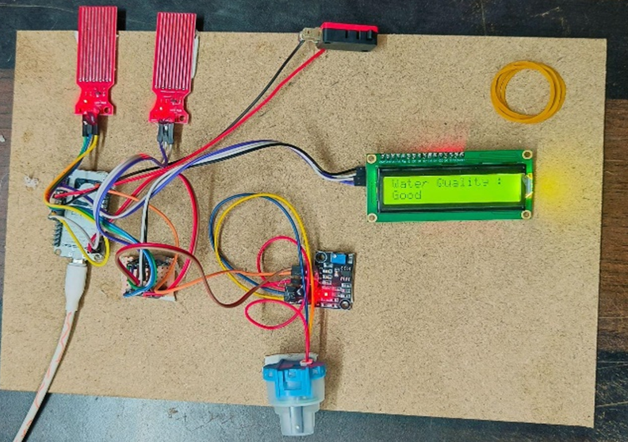
Results
The Hardware setup of the Contain Based Sewage Monitoring System is given in figure below

Slide 22
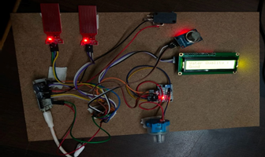
Results
The results should be analyzed in the following steps:-
Step 1: Water Quality Monitoring
We observed that turbidity levels were consistently and accurately measured for water quality monitoring. The following image shows the water quality data presented on the LCD and the sewage monitoring app. The graph graphically illustrates turbidity levels over a given period, while numerical values indicate the present turbidity condition. Additionally, the system's status indications, which indicate water quality as Good, Fair, or Poor, are emphasized for easy recognition.
Fig . Hardware Implementation

Slide 23
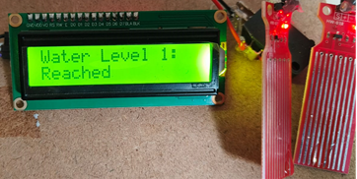
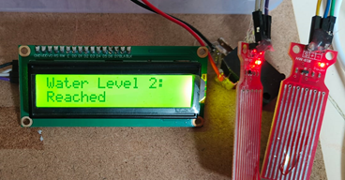
Results
Step 2: Water Level Monitoring
The system accurately measured and showed real-time water levels in the water level monitoring section. Figures shows the water level sensor incorporated into the sewage system and the readings on the LCD and the sewage monitoring app . Figures below displays the water level sensor in action, while the LCD and app interfaces provide current water level information. The picture is annotated to highlight the sensor and its results, visually representing the system's water level monitoring capabilities.
Fig . Water level Sensor1 Status Reached
Fig . Water level Sensor2 Status Reached

Slide 24
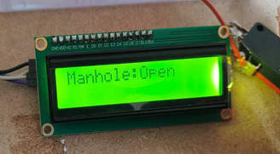
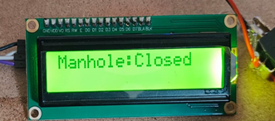
Results
Step 3: Manhole Detection
The LCD and sewage app interface are shown side by side, including real-time manhole status data. Arrows and highlights in the image draw attention to the limit switch and the displayed manhole status, which improves understanding of the system's manhole detection capability. Figure shows an image-based representation of the manhole detection system, which includes a limit switch .The manhole detection component successfully identified and presented the state of manholes as Open or Closed.
Fig .Limit Switch Shows Status Open
Fig .Limit Switch Shows Status Closed

Slide 25
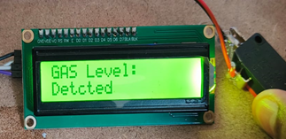
Results
Step 4: Gas Detection
For gas detection, the system accurately measured and presented gas concentration levels. Figure below displays the gas detection data as shown on the LCD and via the sewage monitoring app. A graph displays the concentration levels measured by the sensor over time and numerical values representing the current gas concentration status. The system's status indications, which show air quality as Safe, Caution, or Unsafe, are additionally highlighted for clarity. The image contains an arrow or highlight pointing to the gas sensor in the sewage system, providing information about its installation and operation.
Fig .Gas Sensor Shows Status Detected

Slide 26
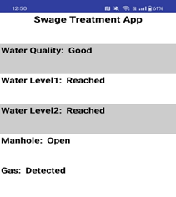
Results
Step 5: Application in Real-World Scenarios
The Contain-Based Sewage Monitoring System with IoT showed outstanding results in real-world sewage monitoring applications. Figure depicts the system in sewage monitoring, emphasizing its practical use and impact. The graphic and associated data points demonstrate the system's performance in a variety of settings .Water quality: The system maintains good water quality, ensuring environmental sustainability .Water Level: The system detects and displays water levels precisely, with measurements showing that safety requirements have been achieved in Water Levels 1 and 2.Manhole Detection: The technology successfully recognizes and shows the state of manholes, showing whether they are open or closed, allowing for more efficient sewage management .Gas detection: The device accurately monitors and displays gas concentrations, guaranteeing a safe air quality status.
Fig . Application Interface

Slide 27
Advantages
Real-time Monitoring: This system continuously monitors sewage quality parameters such as water quality, hazardous gasses, flow rate, water level, and manhole status. This allows for early identification and reaction to deviations or contamination incidents, reducing possible environmental risks.
Cost-effective: By integrating IoT technologies and centralized cloud-based platforms, CBSMS removes the need for human monitoring and lowers the operating expenses associated with traditional wastewater management systems.
Environmental Safety: This system's comprehensive sensor network and cognitive monitoring capabilities assure compliance with environmental rules by identifying and quantifying dangerous substances and gases in sewage, protecting human health and the environment.
Predictive Maintenance and Optimization: Modern analytics and machine learning algorithms enable predictive maintenance and optimization of sewage systems, improving operational effectiveness and resources.
Scalability and adaptability: Its flexible framework and scalability enable it to meet a wide range of sewage management requirements, from individual containment units to large-scale urban wastewater systems.
Transparency and Accountability: By providing stakeholders with complete and transparent data via cloud platforms and mobile applications, CBSMS encourages transparency and informed decision-making in urban wastewater management.

Slide 28
Applications
Urban Wastewater Management: It may be used in municipal sewage systems to track and control sewage quality in real-time, ensuring compliance with environmental rules and protecting public health.
Industrial Wastewater Treatment: Companies may use this system to monitor effluent quality and optimize wastewater treatment operations, lowering operating costs and environmental effects.
Agricultural Runoff Monitoring: In agricultural settings, it may be used to monitor nutrient levels and pollutant concentrations in runoff water, preventing pollution from water bodies and groundwater sources.
Water Quality Monitoring in Rivers and Lakes: This may be used in natural water bodies to monitor sewage flows and detect pollution events, allowing for early actions to safeguard aquatic ecosystems and human health.
Flood Management: This system may be linked with flood monitoring systems to monitor sewage levels and flow rates in drainage systems, allowing for earlier identification of flood threats and better emergency response.
Construction Site Wastewater Management: This system may be used on construction sites to monitor and manage wastewater created during construction operations, maintaining compliance and reducing environmental impact.
Rural and Off-grid Locations: This system may be used in rural or off-grid locales where standard sewage monitoring infrastructure is impractical, offering a cost-effective and scalable solution for monitoring sewage quality and controlling wastewater.
Research and Development: Researchers and environmental scientists may use it to monitor and investigate sewage quality and its influence on aquatic ecosystems and public health.

Slide 29
Conclusion
The IOT-based sewage monitoring system not only improves resource management, public health, and environmental protection but also signifies a technological leap in urban planning. Its real-time monitoring reduces environmental harm, ensuring water body safety, and promoting a healthier ecosystem. The system's scalability and data-driven approach promise sustainable sewage treatment, emphasizing a future of smart and resilient cities.

Slide 30
Future Scope
The future of containment-based sewage monitoring using IoT looks promising with advancements in sensor technology, enhanced connectivity via 5G, and the integration of artificial intelligence for data analysis and optimization. Blockchain promises improved data security, while smart city integration offers more sustainable urban development. Augmented and virtual reality tools could enhance visualization and training, and there is potential for broader environmental monitoring. Future systems will prioritize scalability and modularity, adapting to evolving technological needs and fostering innovation in sewage management practices.

Slide 31
References
[1] Zhu, Wanhao, Zhidong Wang, and Zifan Zhang. "Renovation of automation system based on Industrial Internet of Things: A case study of a sewage treatment plant." Sensors 20.8 (2020): 2175.
[2] Kumar, Priyan Malarvizhi, and Choong Seon Hong. "Internet of things for secure surveillance for sewage wastewater treatment systems." Environmental Research 203 (2022): 111899.
[3] Duo Zhang, Geir Lindholm, Harsha Ratnaweera, Use long short-term memory to enhance Internet of Things for combined sewer overflow monitoring, Journal of Hydrology, Volume 556, 2018, Pages 409-418, ISSN 0022-1694, https://doi.org/10.1016/j.jhydrol.2017.11.018.
[4] O. Gonsor, "SMART SYSTEM FOR MONITORING WATER QUALITY PARAMETERS," Measuring Equipment and Metrology, vol. 83, no. 4, pp. 18–23, 2022, doi: 10.23939/istcmtm2022.04.018.
[5] A. Pendharkar, J. Chillapalli, K. Dhakate, S. Gogoi, and Y. Jadhav, "IoT Based Sewage Monitoring System," SSRN Electronic Journal, 2020, Published, doi: 10.2139/ssrn.3697395.
[6] "SMART FLOOD MONITORING SYSTEM," Journal of Southwest Jiaotong University, vol. 58, no. 4, 2023, doi: 10.35741/issn.0258-2724.58.4.13.
[7] C. Zhao, H. Liu, Y. Guo, and L. An, "Sewage system diagnosis based on online monitoring technology," Water International, vol. 48, no. 3, pp. 322–330, Apr. 2023, doi: 10.1080/02508060.2023.2204616.
[8] B. Jiang, Q. Qi, P. Liu, and Y. Chen, "Monitoring system of sewage index cloud platform," DESALINATION AND WATER TREATMENT, vol. 122, pp. 231–235, 2018, doi: 10.5004/dwt.2018.22803.
[9] S. Bhutada, S. More, T. Shrivastav, C. Suryawanshi, and P. Suryawanshi, "IoT Based Smart Sewage Monitoring System for Smart City," International Journal for Research in Applied Science and Engineering Technology, vol. 10, no. 11, pp. 1702–1707, Nov. 2022, doi: 10.22214/ijraset.2022.47704.
[10] J. H. Rony, N. Karim, MD. A. Rouf, Md. M. Islam, J. Uddin, and M. Begum, "A Cost-Effective IoT Model for a Smart Sewerage Management System Using Sensors," J, vol. 4, no. 3, pp. 356–366, Jul. 2021, doi: 10.3390/j4030027.

Slide 32
References
[11] P. B. Et al., "IOT BASED SYSTEM FOR DETECTION OF SEWAGE BLOCKAGES," INFORMATION TECHNOLOGY IN INDUSTRY, vol. 9, no. 1, pp. 961–970, Mar. 2021, doi: 10.17762/itii.v9i1.224.​
[12] S. B. Keshipeddi, "IoT Based Smart Water Quality Monitoring System," SSRN Electronic Journal, 2021, Published, doi: 10.2139/ssrn.3904842.​
[13] P. Søstrand, B. Tvedt, W. Eduard, E. Bye, and K. Heldal, "Hazardous Peak Concentrations of Hydrogen Sulfide Gas Related to the Sewage Purification Process," AIHAJ, vol. 61, no. 1, pp. 107–110, Jan. 2000, [Online]. Available: http://dx.doi.org/10.1202/0002-8894(2000)061<0107:hpcohs>2.0.co;2​
[14] "SECURE MANHOLE MONITORING SYSTEM USING IOT," Journal of Xidian University, vol. 15, no. 7, Jul. 2021, doi: 10.37896/jxu15.7/038.​
[15] S. Himanshu, "IOT-based Manhole Detection and Monitoring System," International Journal for Research in Applied Science and Engineering Technology, vol. 10, no. 6, pp. 1608–1613, Jun. 2022, doi: 10.22214/ijraset.2022.43862.​
[16] "Low-power Environmental Monitoring System for ZigBee Wireless Sensor Network," KSII Transactions on Internet and Information Systems, vol. 11, no. 10, Oct. 2017, doi: 10.3837/tiis.2017.10.006.​
[17] "Design of Oil Pipeline Monitoring System based on Wireless Sensor Network," Iraqi Journal of Computer, Communication, Control, and System Engineering, pp. 53–62, Sep. 2018, doi: 10.33103/uot.ijccce.18.2.5.​
[18] S. Kumar, S. Kumar, P. M. Tiwari, and R. Viral, "Smart Safety Monitoring System for Sewage Workers with Two Way Communication," 2019 6th International Conference on Signal Processing and Integrated Networks (SPIN), Mar. 2019, Published, doi: 10.1109/spin.2019.8711628.​
[19] A. Pendharkar, J. Chillapalli, K. Dhakate, S. Gogoi, and Y. Jadhav, "IoT Based Sewage Monitoring System," SSRN Electronic Journal, 2020, Published, doi: 10.2139/ssrn.3697395.​
[20] J. Chillapalli and Y. H. Jadhav, "IoT based Sewage gas Monitoring and Alert System using Raspberry PI," International Journal of Scientific Research in Computer Science, Engineering and Information Technology, pp. 567–573, Aug. 2020, doi: 10.32628/cseit12064114.​
​

Slide 33
Project Outcomes
Participated in the Abhiyantrix 2024 college paper presentation competition, held online and organized by PCCOE's Department of Electronics & Telecommunication in Pune.

Slide 34
THANK YOU
Any Questions?

